Slide 1
Spring Boot Microservice
Vivek Gohil

Slide 2
Agenda
Secure Coding Standards
Input Validation and Sanitization
Secure Exception Handling
Avoid Sensitive Data Exposure
Secure Logging
Safe File Upload
Prevent Common Attacks
Code Quality and best practices
Solid Principles
Reusable Service Structure
Performance Optimization
Observability and Metrics
Secure Deployment Checklist

Slide 3
Secure Coding Standards
Why Security Matters ?
Real-world breaches (data leaks, SQL injection)
Cost of insecure code
Developer responsibility

Slide 4
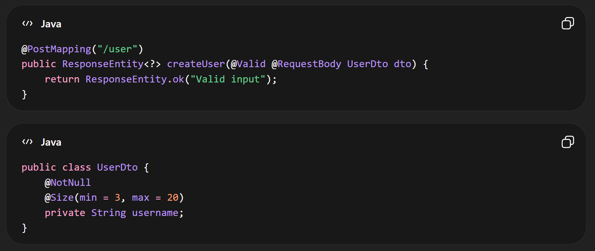
Input Validation and Sanitization
Key Points
Never trust user input
Validate at controller level
Use annotations

Slide 5
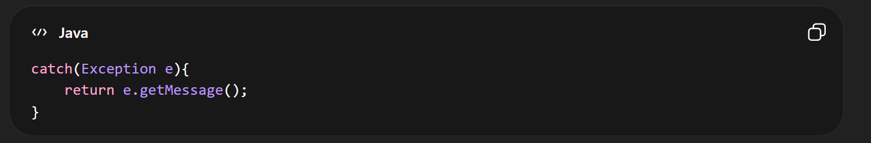
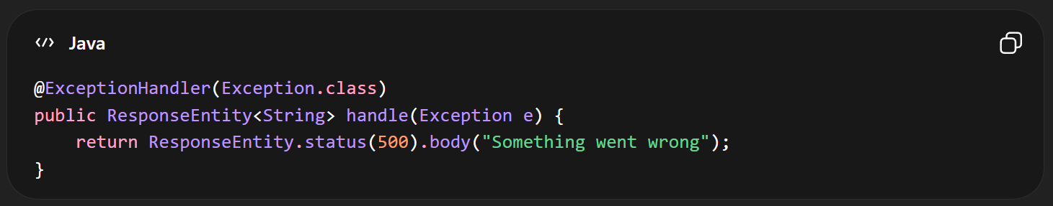
Secure Exception Handling
Bad
Good

Slide 6
Avoid Sensitive Data Exposure
Don’t return
Passwords
Tokens
Internal IDs
Use DTOs

Slide 7
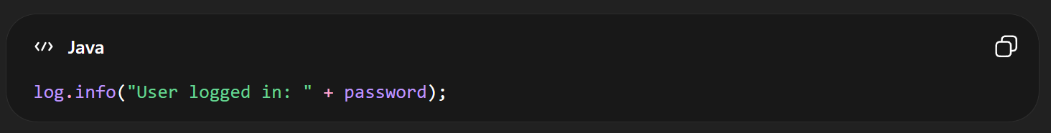
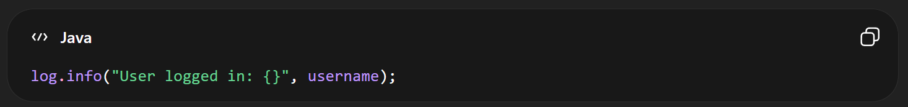
Secure Logging
Wrong
Correct

Slide 8
Safe File Upload
Validate file type
Limit size
Store outside project

Slide 9
Prevent Common Attacks
SQL Injection
Use JPA / Prepared Statements
CSRF
Enable Spring Security CSRF protection

Slide 10
Code Quality & Best Practices
Clean Code
Meaningful names
Small methods
No duplicate code

Slide 11
SOLID Principles
S – Single Responsibility
O – Open/Close
L – Liskov Substitution
I – Interface Segregation
D – Dependency Injection

Slide 12
Reusable Service Structure
Layered architecture
Controller
Service
Repository

Slide 13
Performance Optimization
Memory and GC Basics
Heap usage
Minor GC / Major GC
Object creation cost

Slide 14
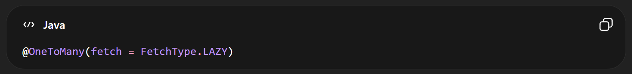
Lazy Loading
Load data when needed

Slide 15
Database Optimization
Use indexes
Avoid N+1 queries
Use pagination

Slide 16
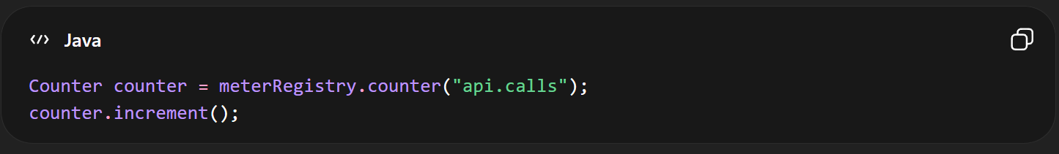
Observability and Metrics
Use Spring Boot Actuator

Slide 17
Secure Deployment Checklist
Environment Separation
Dev
QA
Prod
Property Encryption
Secret Management
Use env variables
Never hardcode secrets

